Slide 1
Carbon Pricing in NYISO’s Wholesale Energy Market
And applicability to multi-state RTO markets
Presented to
Energy Policy Roundtable in the PJM Footprint
Presented by
Sam Newell
May 23, 2018

Slide 2
Agenda
How prices can harmonize wholesale markets and state policy
Carbon charges vs. alternative carbon pricing mechanisms
Estimated impacts on emissions and costs
Implementation Challenges
Focus on leakage
Translation to integrated markets w/multiple carbon regimes

Slide 3
Carbon Pricing versus the Status Quo
Status Quo
Carbon Pricing
Alignment with State Goals
Lacking alignment
Harmonized
Cost-Effective Abatement
Targeted measures
More opportunities;
Select the most economic
Wholesale Energy Prices
Prices lowered by crediting RECs/ZECs
Prices raised by charging emissions

Slide 4
Carbon Charge versus Alternative Mechanisms
Carbon Charge
NY Cap-and-Trade
Carbon Tax
RGGI+

Slide 5
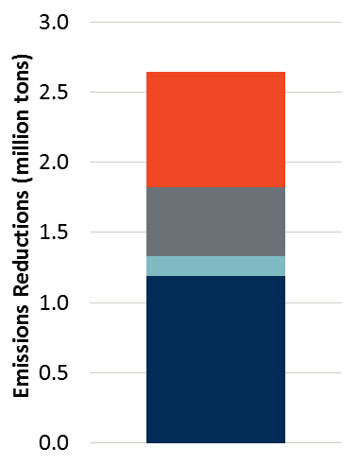
Emissions Abatement & Economic Efficiency Gains
We estimate a $40/ton CO₂ charge could reduce NY CO₂ emissions by 2.6m tons/yr
Indicative, based on reasonable assumptions
Excl. changes to commitment and dispatch
Could replace costlier abatement
E.g., 6.3 TWh less REC procurement could reduce economic costs by $120 million/yr
Indicative Estimate of Abatement
Tilting Renewable Investment
Supporting Investment in CCs
Incorporating Storage and DR
Incentivizing EE and Conservation

Slide 6
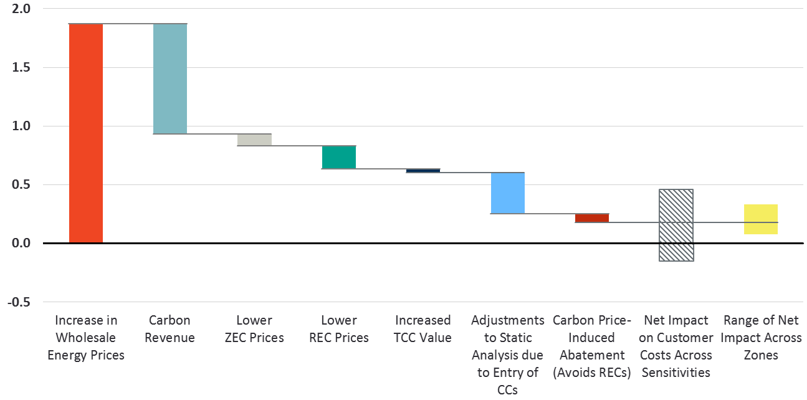
Net Impact on Customer Costs is Relatively Small
+1.9¢
-0.9¢
-0.1¢
-0.2¢
-0.03¢
-0.4¢
-0.1¢
-0.15 to
+0.46¢
+0.08 to
+0.33¢
Net impact ranges from −0.15 to +0.46¢/kWh, amounting to −1% to +2% change in average bills.
¢/kWh (2025 $s)
Central value: +0.17 ¢/kWh
Increase in Wholesale Energy Prices
Carbon Revenue
Lower ZEC Prices
Lower REC Prices
Increased TCC Value
Adjustments to Static Analysis due to Entry of CCs
Carbon Price- Induced Abatement (Avoids RECs)
Net Impact on Customer Costs Across Sensitivities
Range of Net Impact Across Zones

Slide 7
Market Design Issues
Major Policy Questions
Energy Market Mechanics
Interaction with Other Processes
Price of CO₂ to be Set by PSC
Applies to All Internal Resources’ C/D/Settlement
Tx Planning and Net CONE
Carbon Residuals Allocated to LSEs
External Transactions Compete on “Status Quo” Basis
Other State Policies and Programs?

Slide 8
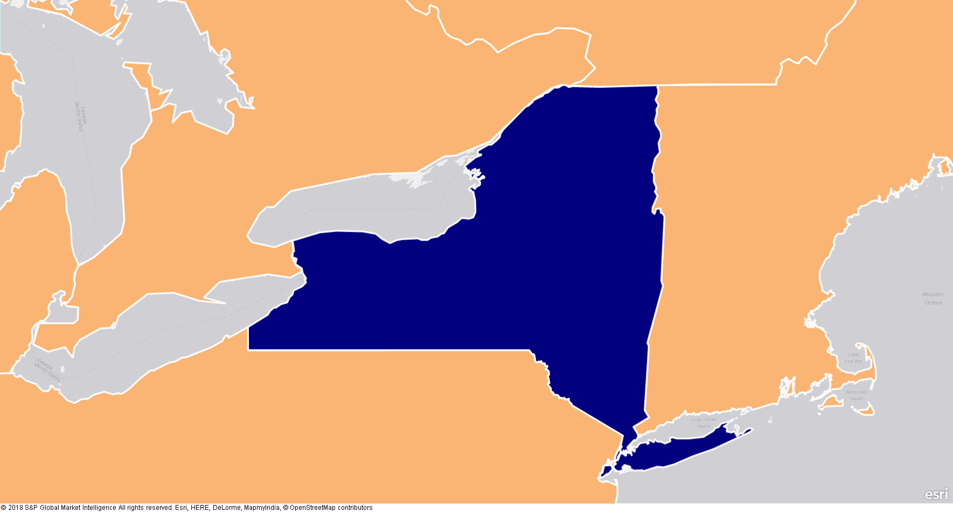
External Transactions
NYCA had net imports of 22 TWh in 2016, serving 14% of NYCA load
12 TWh
HQ
8 TWh
IESO
ISO-NE
-6 TWh
Internal Load= 161 TWh
Internal Gen = 138 TWh
PJM
9 TWh
Sources: Brattle analysis of NYISO Interface Flows and Limit data from various sources (see appendix).

Slide 9
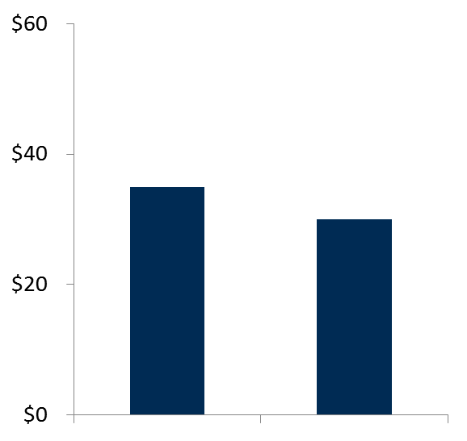
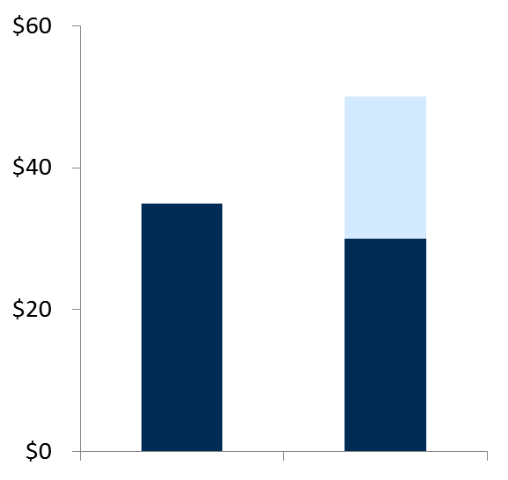
Carbon Pricing without Border Adjustments
Charging only internal resources disfavors them; shifts production outside NY (imports ↑, exports ↓), increases production costs, and leaks emissions (possibly increasing overall)
Status Quo
No Carbon Charges
NYISO Carbon Pricing
No Charges on Imports or Credits on Exports
Lower cost if not charged for emissions
Carbon Charge
Higher cost
Operating Costs
Operating Costs
Neighbor
Marginal Unit
NYISO
Marginal Unit
Neighbor
Marginal Unit
NYISO
Marginal Unit

Slide 10
Two Approaches to Preventing Distortions
Need to re-level the playing field to prevent distortions, in one of two ways
Option 1: External transactions compete on a status-quo basis
Consistent with objective to reduce internal emissions w/o imposing NY’s view of externalities on trade
Imports/exports unchanged
Relatively simple and transparent
Option 2: External transactions compete on a green-power basis
Consistent with an objective to reduce global emissions with serving NY load (and using NY gen), when cost effective given externalities
Approach used in CA, Ontario, Quebec
Rates difficult to determine and benefits may be moderate

Slide 11
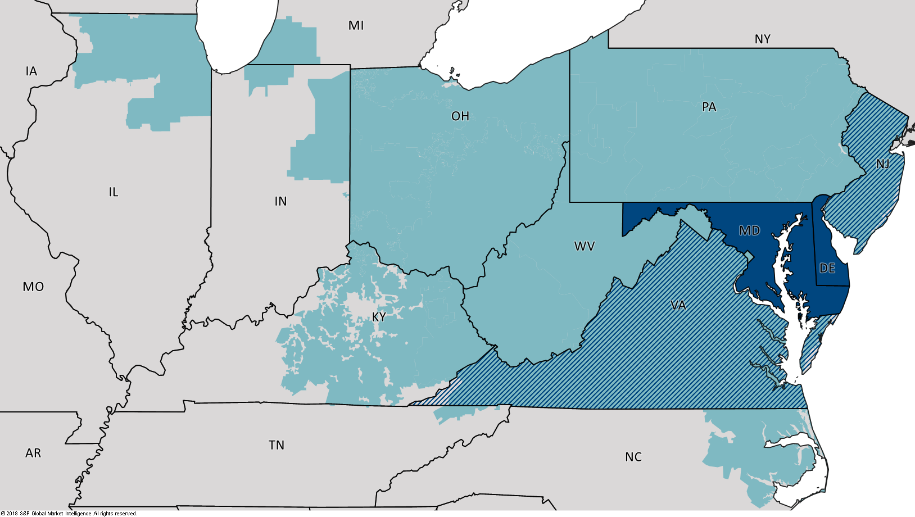
Leakage in an RTO with Multiple Carbon Regimes
PJM Footprint
Current RGGI
Future
RGGI

Slide 12
Presenter Information
Sam Newell
Principal │ Boston
Sam.Newell@brattle.com
+1.617.864.7900
Dr. Samuel Newell, a Principal of The Brattle Group, is an economist and engineer with 20 years of experience consulting to the electricity industry. His expertise is in the design and analysis of wholesale electricity markets and in the evaluation of energy/environmental policies and investments, including in systems with high penetration of variable energy resources. He supports clients in regulatory, litigation, and business strategy matters involving wholesale market design, contract disputes, generation asset valuation, benefit-cost analysis of transmission enhancements, the development of wholesale demand response programs, and integrated resource planning. He frequently provides testimony and expert reports to RTOs, state regulatory commissions, and the FERC and has testified before the American Arbitration Association.
Dr. Newell earned a Ph.D. in Technology Management & Policy from MIT, an M.S. in Materials Science & Engineering from Stanford University, and a B.A. in Chemistry & Physics from Harvard. Prior to joining Brattle, Dr. Newell was Director of the Transmission Service at Cambridge Energy Research Associates.
The views expressed in this presentation are strictly those of the presenter(s) and do not necessarily state or reflect the views of The Brattle Group.

Slide 13
About Brattle
The Brattle Group provides consulting and expert testimony in economics, finance, and regulation to corporations, law firms, and governments around the world. We aim for the highest level of client service and quality in our industry.
We are distinguished by our credibility and the clarity of our insights, which arise from the stature of our experts, affiliations with leading international academics and industry specialists, and thoughtful, timely, and transparent work. Our clients value our commitment to providing clear, independent results that withstand critical review.

Slide 14
Our Practices
ENERGY & UTILITIES
Competition & Market
Manipulation
Distributed Energy
Resources
Electric Transmission
Electricity Market Modeling
& Resource Planning
Energy Litigation
Environmental Policy, Planning
and Compliance
Finance and Ratemaking
Gas/Electric Coordination
Market Design
Natural Gas & Petroleum
Nuclear
Renewable & Alternative
Energy
LITIGATION
Accounting
Analysis of Market
Manipulation
Antitrust/Competition
Bankruptcy & Restructuring
Big Data & Document Analytics
Commercial Damages
Environmental Litigation
& Regulation
Intellectual Property
International Arbitration
International Trade
Labor & Employment
Mergers & Acquisitions
Litigation
Product Liability
Securities & Finance
Tax Controversy
& Transfer Pricing
Valuation
White Collar Investigations
& Litigation
INDUSTRIES
Electric Power
Financial Institutions
Natural Gas & Petroleum
Pharmaceuticals
& Medical Devices
Telecommunications,
Internet, and Media
Transportation
Water

Slide 15
Offices
BOSTON
New York
San Francisco
Washington, dc
Toronto
London
Madrid
Rome
Sydney

